Slide 1

Machine learning Algorithms using wine dataset

Slide 2
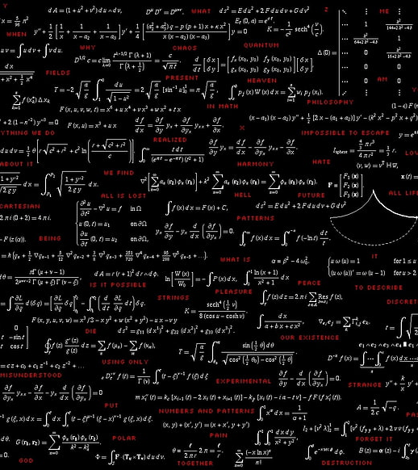
Members
2021BEC103 – Shradha sangave
2021BEC105 – Prajakta Shinde
2021B3C113 – omkar dikshit
2021BEC115 – Riddhim Rathor

Slide 3
Comparison table
Parameters | KNN | Logistic regression | Random Forest | Naïve bayes
Type | Supervised | Supervised | Supervised | Supervised
Accuracy | 0.65 | 0.97 | 0.98 | 0.79
F1 score | 0.7424 | 1.0000 | 1.0000 | 1.0000
Sensitivity | 0.656 | 0.9473 | 0.9334 | 0.9500
Specificity | 0.8823 | 0.9411 | 1.0000 | 1.0000

Slide 4

KNN algorithm
Step #1 - Assign a value to K.
Step #2 - Calculate the distance between the new data entry and all other existing data entries (you'll learn how to do this shortly). Arrange them in ascending order.
Step #3 - Find the K nearest neighbors to the new entry based on the calculated distances.
Step #4 - Assign the new data entry to the majority class in the nearest neighbors.
This Photo by Unknown Author is licensed under CC BY

Slide 5
Logistic regression
1. Initialize Parameters: Start by initializing the weights (coefficients) and the bias term. Typically, these are initialized to zeros or small random values.
2. Calculate Predictions: Use the initialized weights and bias to compute the predicted probabilities for each data point. This involves passing the input features through a logistic function (sigmoid function) to obtain the probability of the positive class.
3. Compute Loss: Determine how well the model is performing by calculating the loss, which measures the difference between the predicted probabilities and the actual labels. The goal is to minimize this difference.
4. Compute Gradients: Calculate the gradients of the loss function with respect to each parameter (weights and bias). Gradients indicate the direction of steepest ascent of the loss function.
5. Update Parameters: Adjust the weights and bias in the direction that minimizes the loss. This is typically done using gradient descent or its variants, where you take small steps (determined by a learning rate) towards the optimal values of the parameters.
Repeat steps 2-5 until convergence criteria are met, such as reaching a certain level of accuracy or the loss no longer significantly decreasing.
This Photo by Unknown Author is licensed under CC BY

Slide 6
Random forest
1. Random Sampling: Start by randomly selecting a subset of the training data (with replacement) for each tree in the forest. This subset should be of the same size as the original dataset but may contain duplicate samples.
2. Feature Randomness: Randomly select a subset of features from the dataset to use as potential split candidates at each node of the tree. This helps introduce diversity among the trees in the forest.
3. Build Trees: Construct decision trees using the selected subset of data and features. Each tree is grown recursively by selecting the best feature and split point that maximizes information gain (or another criterion) at each node. The process continues until a stopping criterion is met, such as reaching a maximum depth or minimum number of samples per leaf.
4. Voting: For classification tasks, each tree in the forest independently predicts the class label of a new sample. The final prediction is determined by aggregating the individual predictions through majority voting. For regression tasks, the final prediction is often the average of the individual tree predictions.
5. Ensemble: Combine the predictions from all the trees in the forest to make the final prediction. The ensemble approach helps improve the model's robustness and generalization ability by reducing overfitting and capturing the collective wisdom of multiple trees.
Repeat steps 1-5 to build multiple trees in the forest.
This Photo by Unknown Author is licensed under CC BY

Slide 7
Naïve bayes classifier
1. **Prepare Data**: Get your data ready, ensuring it's clean and properly formatted. Convert any categorical data into numerical form if needed.
2. **Compute Class Probabilities**: Count how often each class appears in the dataset and calculate the probability of each class by dividing its count by the total number of instances.
3. **Compute Feature Probabilities**: For each feature, calculate the probability of each value occurring given each class. This is done by counting how often each feature value occurs for each class and dividing by the total count of instances for that class.
4. **Make Predictions**: When given a new instance with feature values, calculate the probability of each class for that instance using Bayes' theorem. Multiply the prior probability of each class by the product of the probabilities of the observed feature values given that class. The class with the highest probability is predicted.
5. **Evaluate and Repeat**: Test the classifier on a separate dataset to evaluate its performance using metrics like accuracy. Adjust and refine the model as needed based on evaluation results.
This Photo by Unknown Author is licensed under CC BY

Slide 8

Thank
YOU

